Slide 1
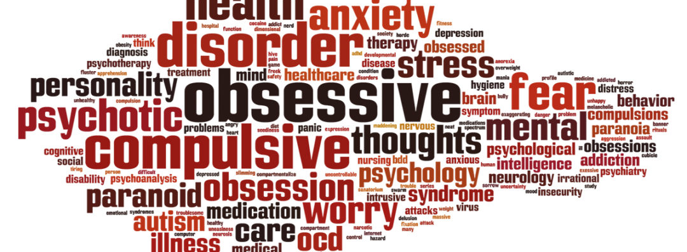
Design Thinking
BTX8081 – Software Engineering and Design Dumitru Georgiana Geanina - Jiménez Norman A.
Schmid Daniel Simon – Tangarife Bonilla Edison Roberto

Slide 2
Table of contents
Project Scope
Documentation and research
Interview
Personas
Features
Storyboards
Prototypes
Discussion

Slide 3
Project Scope

Slide 4
Project Scope
In Scope
Out of Scope
Focus on the treatment of patients with OCD and how to support the medical staff
Adaption and addition of patient data and notifying other actors
Interface to a self-documentation app for the patient
Not a medical device
Does not replace the interactions between the medical staff & patients
Not a complete electronic health record

Slide 5
Documentation and research

Slide 6
Documentation and research
What is OCD?
Obsessive–compulsive disorder (OCD)
The need to perform certain routines repeatedly (called "compulsions")
Certain thoughts repeatedly (called "obsessions")
To an extent which generates distress or impairs general functioning
How is OCD treated?
Psychotherapy
Medication
Or both

Slide 7
Interview

Slide 8
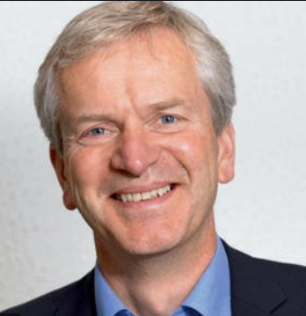
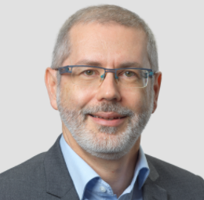
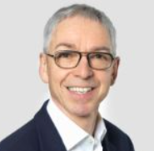
Interview
First contact:
worked at a psych ward
Backup contacts:
In case no contact is established
First contact: 20.10.2020
Second contact: 24.10.2020
Prof. Dr. Holm
Prof. Dr. Lehmann
Prof. Dr. Nüssli

Slide 9

Interview Response
Five open-ended questions
What are the challenges when collecting data on mental illness from a Patient?
What is the most disease-specific data, that a patient must be asked when dealing with psychiatric diseases?
To this day, no response to the emails

Slide 10
Personas

Slide 11
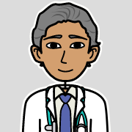
Persona 1
Name | Dr. Petersman
Age | 50 years old
Role | Chief Doctor, Psychiatry, University of Psychiatric Services Bern
Skills | Empathy and compassion; emotional resilience and initiative to work, capacity to monitor developing situations and anticipate issues
Goals | View and edit new patient data. Ability to search and find Patient data
Pain points | Reading the handwriting from other doctors that is illegible

Slide 12

Persona 2
Name | Dr. Noob
Age | 30 years old
Role | Doctor, Psychiatry, University of Psychiatric Services Bern
Skills | Digitally inclined, change oriented, empathic, highly initiative to work and self-growth
Goals | Help as many Patients as possible, by treating the cause of the OCD and not the symptoms
Pain points | Not having access to the most recent Patient medication plan

Slide 13
Features

Slide 14
Features
Notification
when a Patient adds information to the App, the Doctor can read it and take appropriate action
Tracking of patient’s data dynamically over a longer period with better accuracy.
CRUD
create, read, update, delete Information (aka Patients) to the DB
Search Function
Search for Patient in the DB
See medication plan

Slide 15
Storyboards and Prototypes

Slide 16
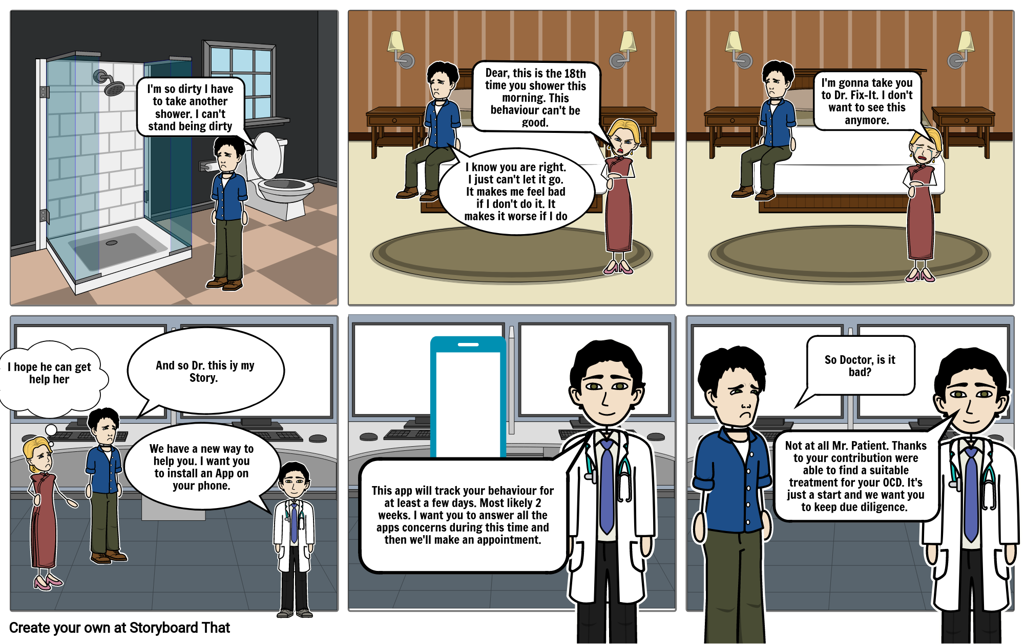
Storyboard 1: Doctor - Patient

Slide 17
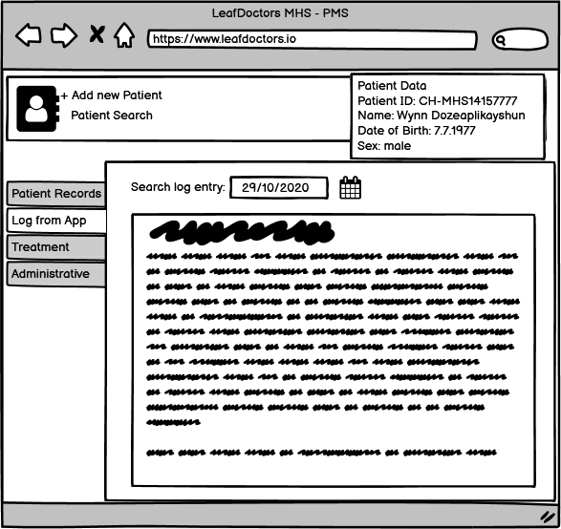
Prototype 1: Doctor – Patient
Doctor can follow the information that a patient provides
A doctor can search for every patient, the data in the MHS – PMS system.
It is also possible to add new patients and new cases accordingly.

Slide 18
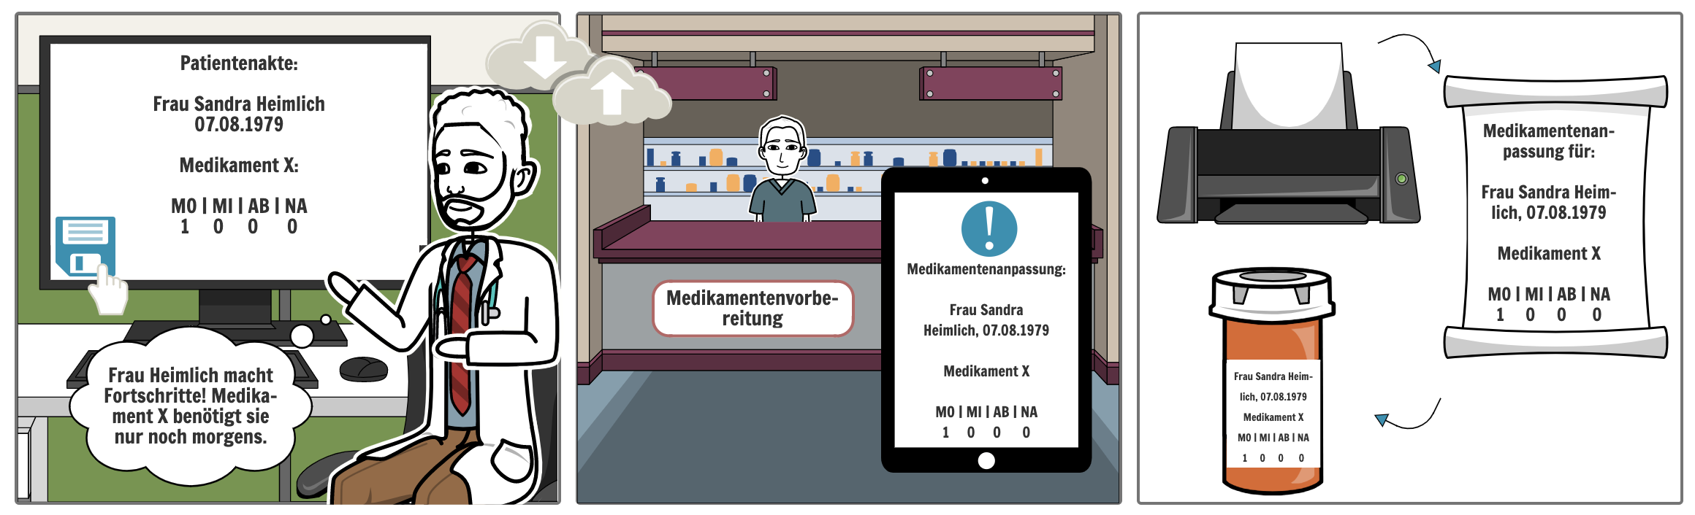
Storyboard 2: Doctor - Nurse

Slide 19
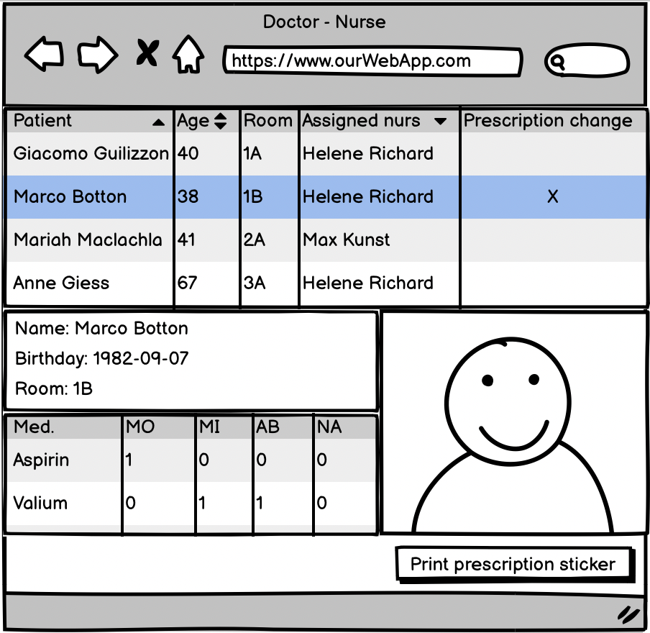
Prototype 2: Doctor - Nurse

Slide 20
Discussion

Slide 21
Thank you!

